Slide 1

PATTERN RECOGNITION AND APPLICATIONS
-Manya Gautam (3CSE10Y)

Slide 2
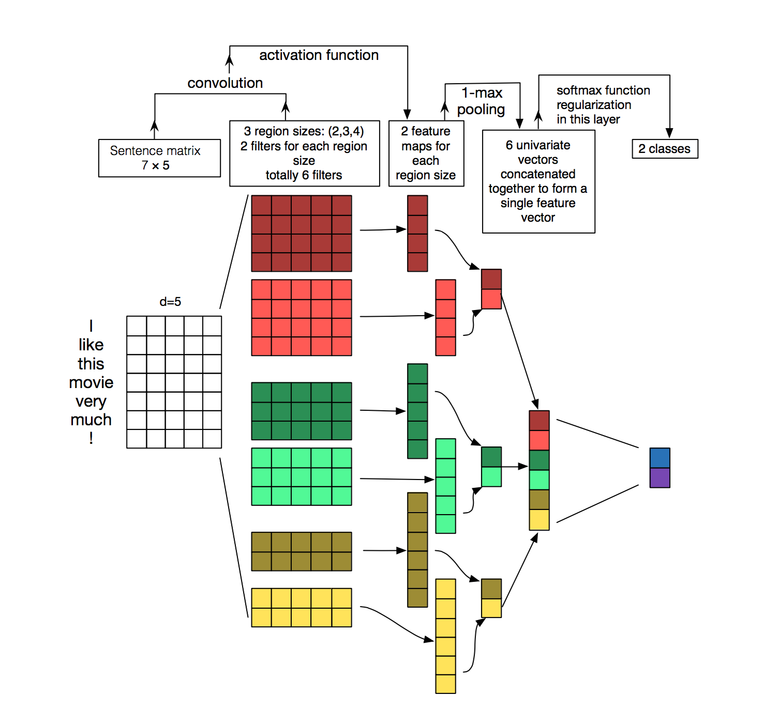
OVERVIEW
Pattern recognition is a fundamental aspect of human cognition and plays a crucial role in various domains, including computer science, psychology, and machine learning.
From recognizing faces to detecting patterns in data sets, pattern recognition is an essential cognitive process that drives numerous applications and research areas
Using machine learning techniques such as convolutional neural networks (CNNs) and Natural Language Processing(NLP), computers can learn to recognize patterns in images by extracting and analyzing various visual features, and understand and process human language respectively.

Slide 3

To summarise, pattern recognition is a multidisciplinary field that encompasses computer science, psychology, and machine learning. It involves the development of algorithms and techniques to identify and interpret recurring structures in data.
From image and speech recognition to natural language processing and cognitive psychology, pattern recognition plays a vital role in various applications and research areas
By leveraging mathematical models and statistical analysis, pattern recognition enables us to extract meaningful insights from complex data, leading to advancements in technology and our understanding of human cognition

Slide 4
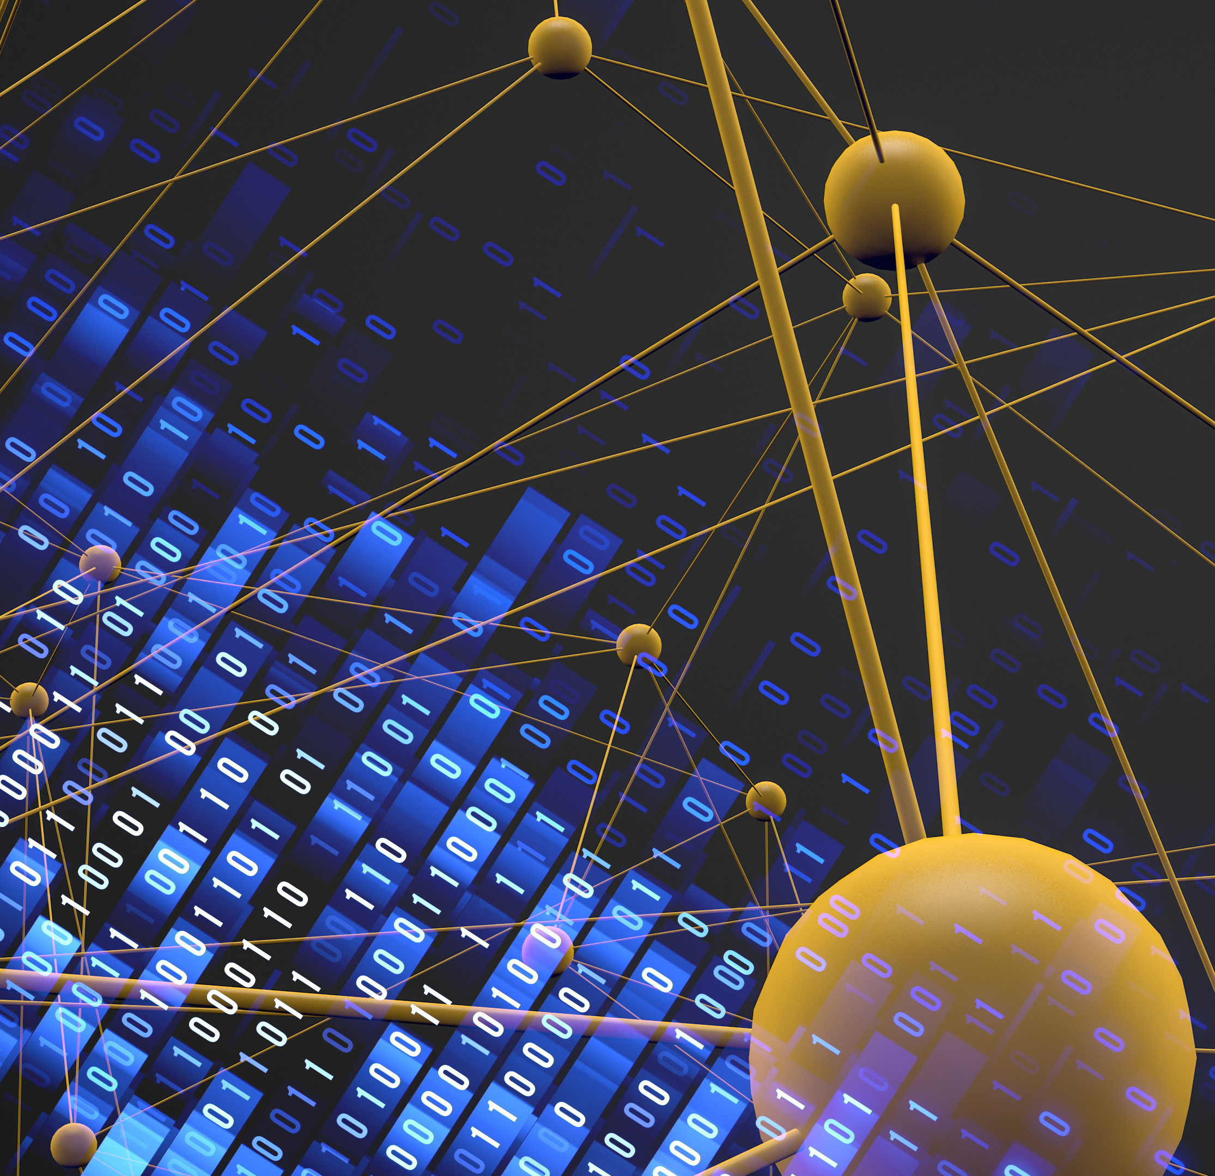
INTRODUCTION TO PATTERN RECOGNITION
1.1 WHAT IS PATTERN RECOGNITION IN ML
Pattern recognition in machine learning refers to the process of identifying and classifying patterns or regularities in data. It involves developing algorithms and models that can automatically detect and extract meaningful patterns from input data.
1.2 OBJECTIVE
The primary objective of pattern recognition in machine learning is to develop algorithms and models that can automatically identify, understand, and classify patterns or regularities in data
A) RECOGNITION
B) ANOMALY DETECTION
C) PREDICTION
D) CLUSTERING
E) FEATURE EXTRACTION

Slide 5
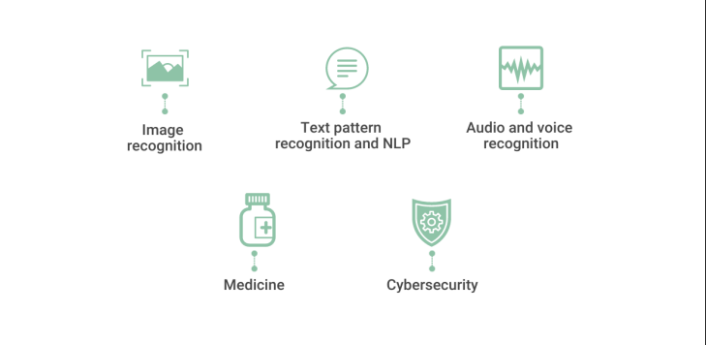
1.3 APPLICATIONS
Pattern recognition has numerous applications across domains. In computer vision, it enables object detection, face recognition, and image classification.
In speech recognition, it aids in speech-to-text conversion and speaker identification. In natural language processing, it facilitates sentiment analysis and text categorization.
In finance, it helps in fraud detection and stock market prediction. In healthcare, it assists in medical image analysis and disease diagnosis.
In robotics, it enables object manipulation and scene understanding.
In manufacturing, it aids in quality control and defect detection.
In cybersecurity, it assists in intrusion detection and malware analysis.

Slide 6
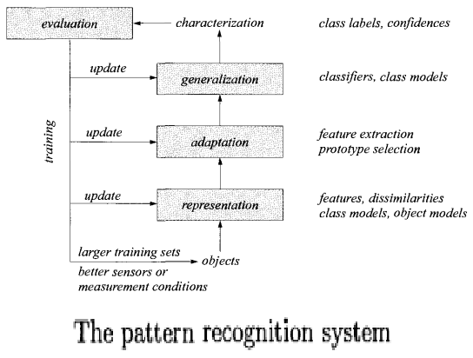
HOW IT WORKS?
Pattern recognition is a sophisticated process that entails the analysis of input data, the extraction of underlying patterns, comparison against predefined standards, and utilizing the acquired results to guide subsequent system actions
One primary function of a pattern recognizer is the automatic identification of familiar patterns. This capability allows the system to efficiently process recurring patterns without requiring extensive manual intervention.
To achieve accurate and reliable pattern recognition, various techniques and algorithms are employed. These may include statistical methods, machine learning algorithms, neural networks, and probabilistic models. These tools enable the system to learn from labeled training data, extract relevant features, and generalize the learned patterns to unseen examples.

Slide 7

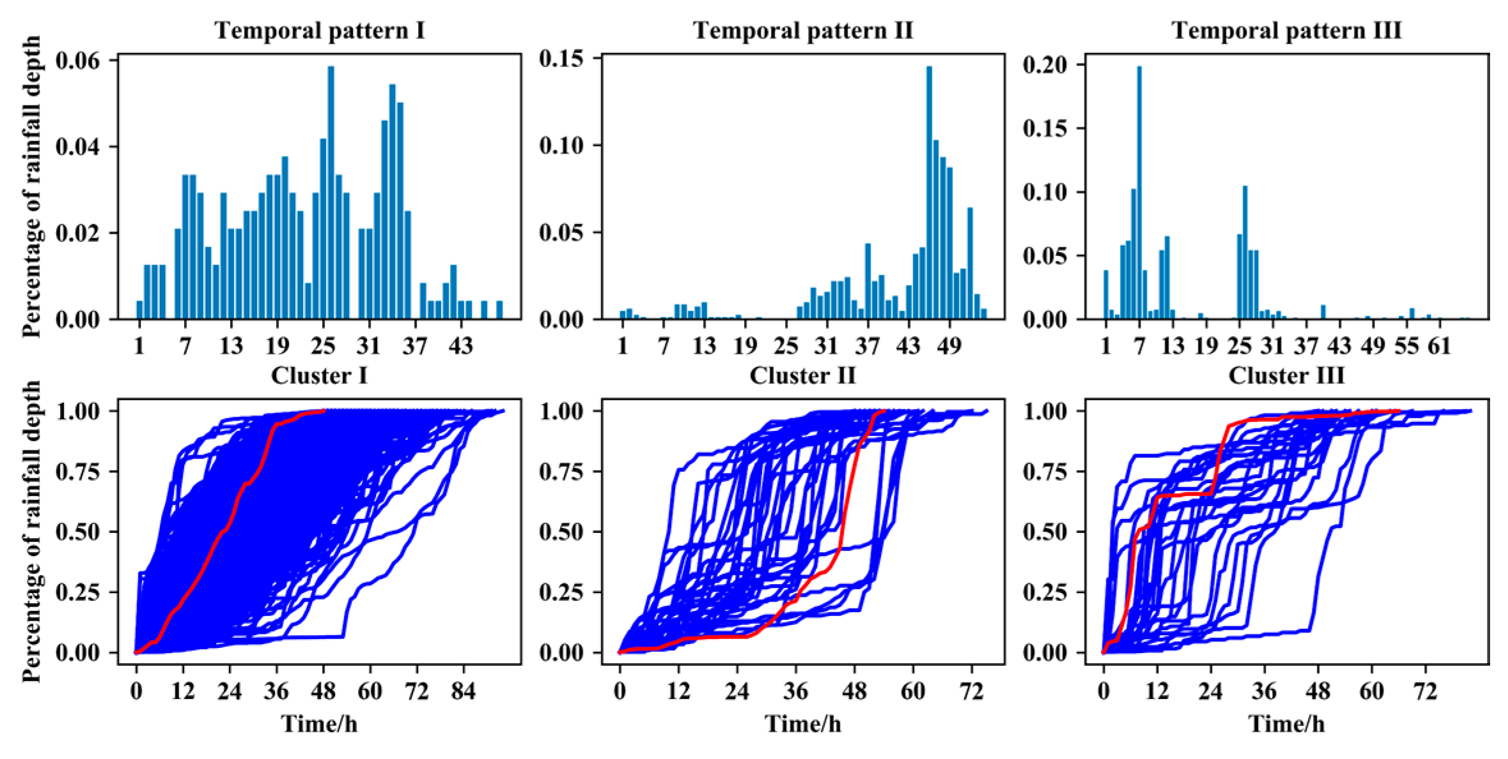
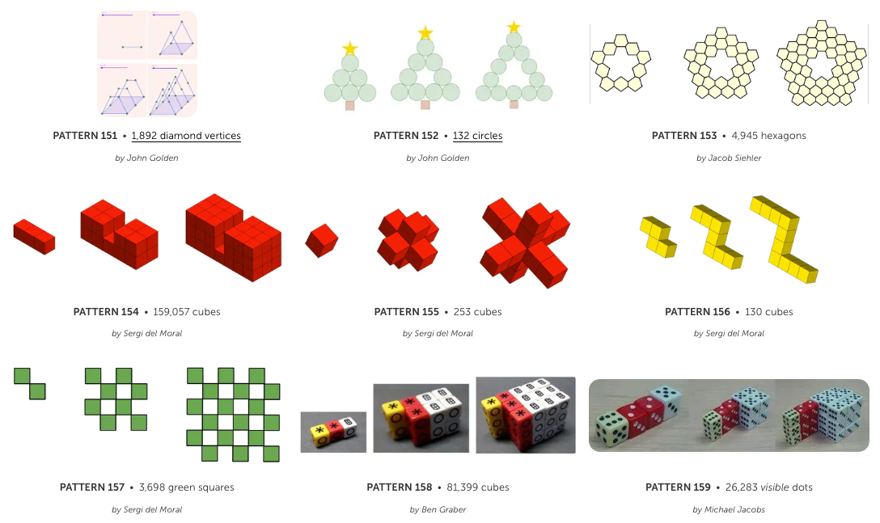
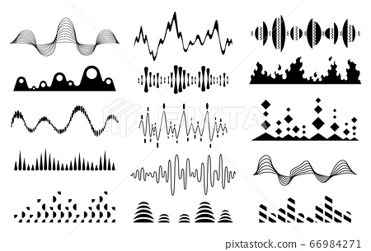
VARIOUS TYPES OF PATTERNS
In the field of AI, there are various types of patterns that are commonly encountered. Here are some of the key types
Geometric Patterns
Temporal patterns
Textual patterns
Visual Patterns
Audio Patterns
Behavioral Patterns
Statistical Patterns
Structural Patterns
Social Patterns
Anomalous Patterns

Slide 8
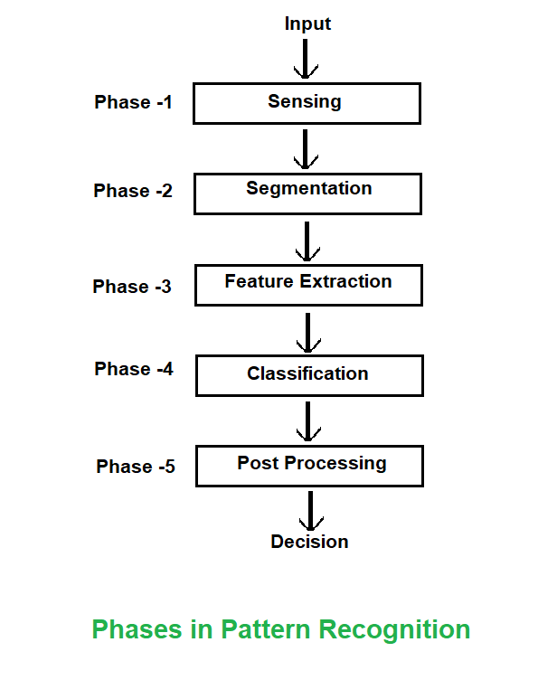
PATH USED IN PATTERN RECOGNITION
Data Collection: The first step is to collect a dataset that contains examples of the patterns or classes you want the system to recognize.
Preprocessing: In this stage, the collected data undergoes preprocessing steps to prepare it for pattern recognition.
Feature Extraction: Feature extraction is the process of identifying and extracting relevant features or characteristics from the preprocessed data.
Feature Selection or Dimensionality Reduction: Feature selection or dimensionality reduction techniques are applied to choose the most informative and discriminative features or reduce the dimensionality of the feature space while preserving essential information
Model Training: After feature extraction, the next step is to train a pattern recognition model using the processed data. The choice of model depends on the specific problem and the characteristics of the data

Slide 9
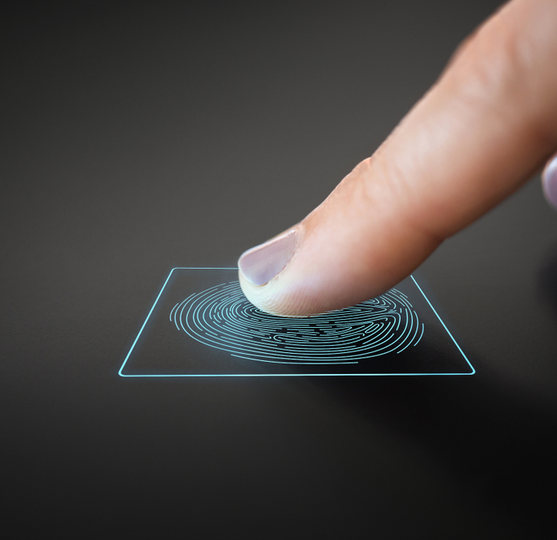
ADVANTAGES OF PATTERN RECOGNITION
Pattern recognition has several advantages in day-to-day life, offering various benefits to individuals and society.
AUTOMATION AND EFFICIENCY: Enables automation off repetitive tasks
PERSONALISATION: Pattern recognition techniques are used to personalize user experience
SECURITY AND SAFETY: Pattern recognition plays a crucial role in security and safety applications.
HEALTHCARE AND MEDICAL DIAGNOSIS: Pattern recognition techniques aid in medical diagnosis and healthcare monitoring.
NATURAL LANGUAGE PROCESSING: Natural language processing (NLP) leverages pattern recognition to understand and process human language.

Slide 10

DISADVANTAGES OF PATTERN RECOGNITION
While pattern recognition has numerous advantages and applications in day-to-day life, there are also some potential disadvantages to consider:
Privacy Concerns: Pattern recognition systems often require access to personal data, such as images, voice recordings, or behavioral patterns.
Lack of Explanation and Interpretability: Some pattern recognition models, particularly deep learning models, can be seen as "black boxes" because they make decisions based on complex internal representations.
Computational Demands: Advanced pattern recognition techniques, such as deep learning, can require significant computational resources, including high-performance hardware and large amounts of training data.
Ethical Considerations: The application of pattern recognition in certain contexts, such as surveillance, biometrics, or social profiling, raises 20 ethical concerns related to privacy, consent, and potential misuse of technology.
Limited Generalization: Pattern recognition models may struggle to generalize well to unseen or novel patterns that differ significantly from the training data.

Slide 11

CONCLUSION
In conclusion, pattern recognition is a powerful field in the realm of artificial intelligence with a wide range of applications.
The applications of pattern recognition are vast and impactful.
In computer vision, it facilitates object detection, image classification, and face recognition. . In speech recognition, it aids in converting speech to text and speaker identification. In finance, it contributes to fraud detection and stock market prediction. In healthcare, it assists in medical image analysis and disease diagnosis
Moreover, pattern recognition finds applications in robotics, manufacturing, cybersecurity, and numerous other fields

Slide 12

However, it is crucial to address potential challenges and concerns related to privacy, bias, limited generalization, and the interpretability of pattern recognition systems.
Ethical considerations must be at the forefront to ensure fair and responsible use of these technologies.
Overall, the advancements in pattern recognition open doors to transformative solutions and decision-making capabilities across various domains, enhancing efficiency, accuracy, and understanding of complex data patterns
Continued research and development in this field will further drive innovation and unlock the full potential of pattern recognition in solving real world problem

Slide 13
THANK YOU FOR TUNING IN!!

